Slide 1




Project
Presentation

Slide 2
Team Members
▪︎ Ali Ramadan
▪︎ Ali Abaza
▪︎ Abdelrahman Waleed
▪︎ Abdelrahman Salah
▪︎ Abdallah Ashraf
▪︎ Mohamed Osama
▪︎ Ward Ahmed

Slide 3
Project Idea
The goal of the project is to build a secure, scalable, and well-structured internal network.
Main objectives:
Use a FortiGate firewall as the main security gateway.
Use a core switch to distribute the network across all departments.
Connect the network to the internet and external routes through a router (R1).
Separate the company into multiple VLANs for better control, performance, and security.
Provide internal services such as servers and monitoring.

Slide 4
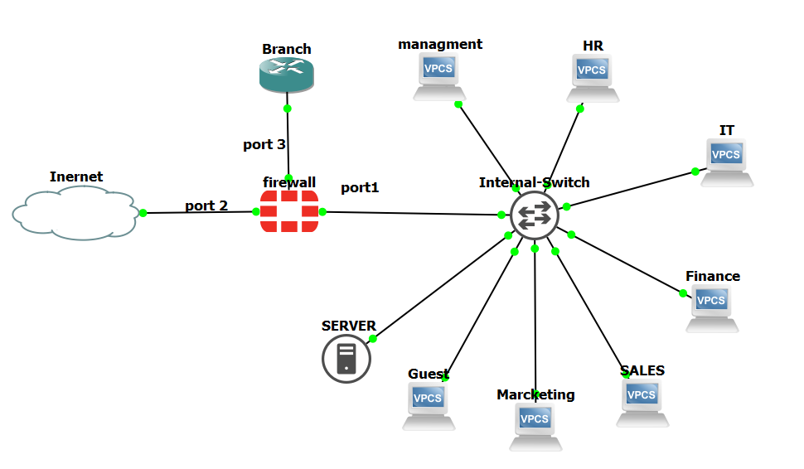
Network Topology Overview
Overall topology flow:
The FortiGate acts as the main security gateway.
The switch distributes traffic to departments individually.
Each department is isolated using VLANs.
The router is used for external routing or ISP communication.

Slide 5
VLANs Summary
  VLAN10 – Management: Used for administrative access and infrastructure management
  VLAN20 – HR: Dedicated to HR systems such as employee records and payroll.
  VLAN30 – IT: Assigned to IT operations, system maintenance, and server administration.
  VLAN40 – Finance: Used by the Finance department for sensitive financial data and applications.
  VLAN50 – Sales: Connected to CRM tools and customer-related systems.
  VLAN60 – Marketing: Provides internet-based functionality with limited internal resource access.
  VLAN70 – Guests: Offers internet access only, with full isolation from internal networks.
  VLAN80 – Servers: Hosts internal servers and critical organizational services

Slide 6
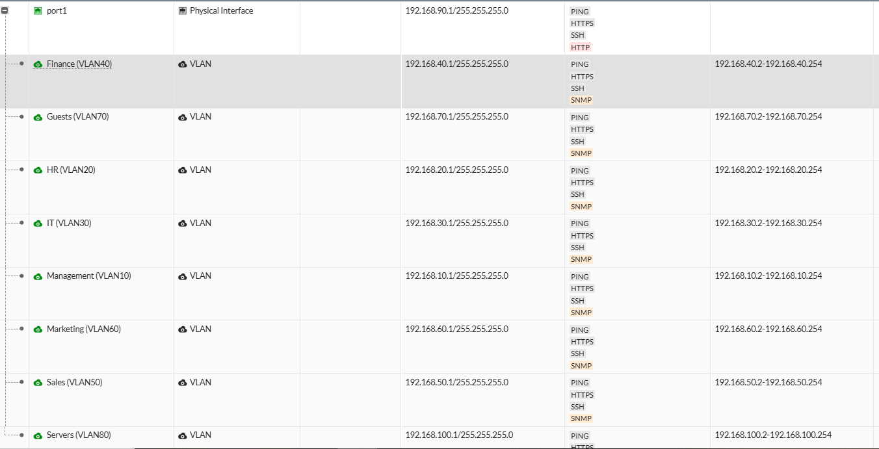
IP Addressing Plan (Example)
VLAN | Department | Subnet | Notes
10 | Management | 192.168.10.0/24 | DHCP enabled
20 | HR | 192.168.20.0/24 | DHCP enabled
30 | IT | 192.168.30.0/24 | Sensitive traffic DHCP enabled
40 | Finance | 192.168.40.0/24 | DHCP enabled
50 | Sales | 192.168.50.0/24 | DHCP enabled
60 | Marketing | 192.168.60.0/24 | DHCP enabled
70 | Guests | 192.168.70.0/24 | Internet only Isolated from others
80 | Servers | 192.168.100.0/24 | Static IPs

Slide 7
Address Groups Overview
To simplify policy creation and ensure consistent control, we organized the environment into several Address Groups:
  Access Internet : VLAN60 and 70; internet access only.
  Access Server: VLAN20 ,40 and 50 ; access to specific internal servers.
  Network Maintenance: Includes multiple VLANs to support monitoring and administrative tasks.
  Protected VLANs: All internal network that must remain isolated from guest access.
  Admins: VLAN10 and 30 for IT and Heads to manage and monitor

Slide 8
Loopback Interface
We configured a Loopback interface on router to see that we can access the other branch for administrative and monitoring functions.
It is used for:
  SNMP monitoring
  SSH management
  Ping testing
This approach ensures stable and reliable management access.
This works after make static route on the FortiGate to see the loopback network

Slide 9
FortiGate Firewall
Overall Configuration:
Interfaces: Create VLAN interfaces and assign IPs.
DHCP: Enable DHCP Server for user VLANs.
NAT: Apply NAT for outbound internet traffic.
Policies: Allow or deny traffic between VLANs based on requirements.

Slide 10
Policy Categories
Our policies are divided into three main categories:
  Internal Access
  Internet Access
  Protection & Isolation

Slide 11
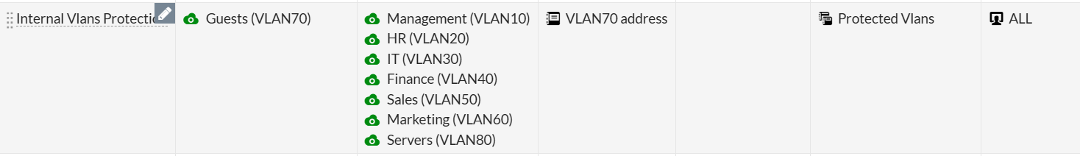
Firewall Policies — Examples
1. GUEST & Marketing can access Internet with NAT
2. Protect Internal VLANS from GUEST

Slide 12
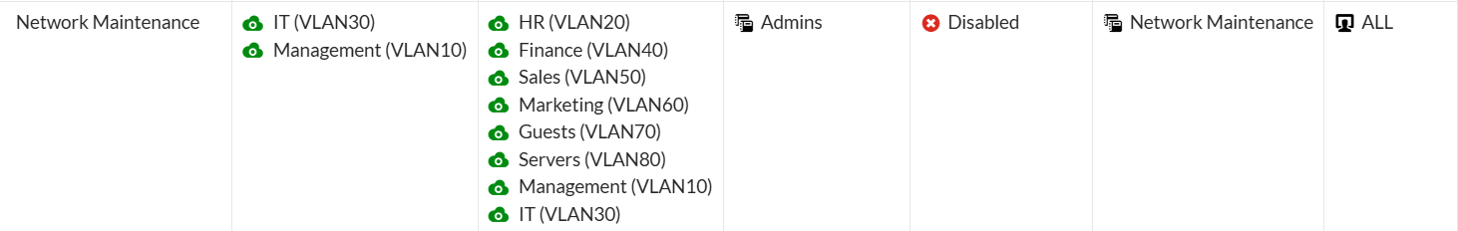
Firewall Policies — Examples
3. Servers to internet (for updates only) scheduled with NAT
4. Admins to all VLANS for monitoring and management

Slide 13
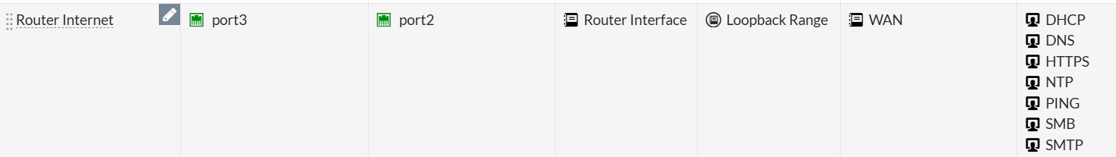
Firewall Policies — Examples
5. Other branch can access Internet
6. Other branch can access IT and Heads for data
7. Other branch can access Internal Servers for data and updates

Slide 14
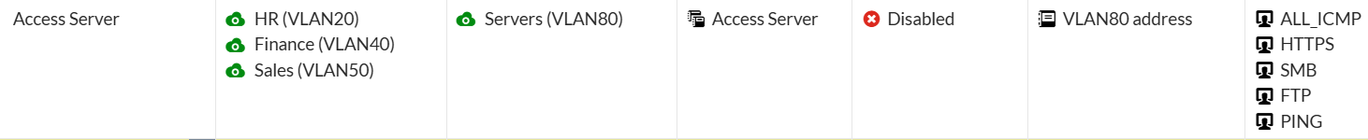
Firewall Policies — Examples
8. Admins and Heads can mange and monitor the other branch
9. HR , finance & Marketing can access file from servers

Slide 15
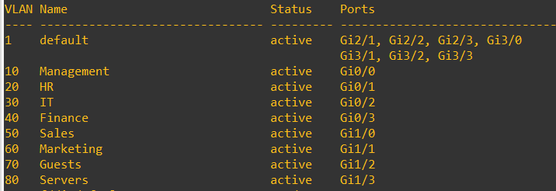
Core Switch Configuration
The core switch handles VLAN assignment and traffic distribution.
Key configurations:
      Create VLANs for each department.
      Set the port connected to FortiGate as a trunk.
      Assign each user port as access to its correct VLAN.

Slide 16
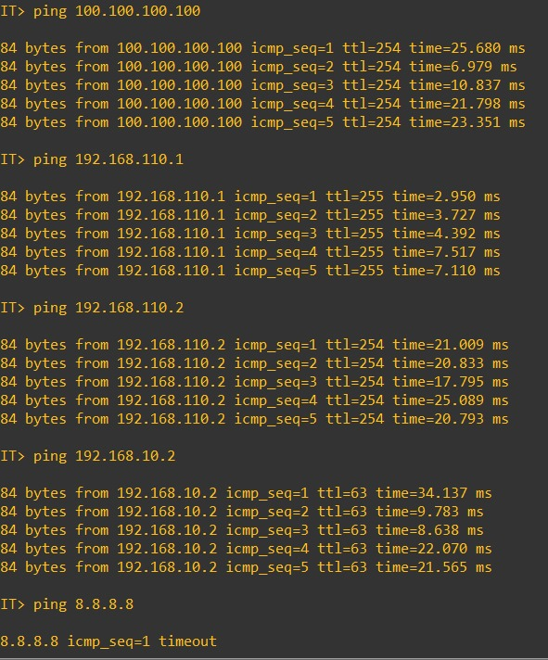
Testing and Validation
Before deploying the network, test:
  Internet access from specific VAlNS ( guest and sales).
  Isolation between departments (e.g., guest cannot reach servers).
  Server access only from authorized VLANs.
  DHCP working properly for each VLAN.
  Firewall logs showing correct allowed/denied traffic.
  Stability under load.

Slide 17
Conclusion
Through structured VLAN design, Address Groups, a Loopback interface, and carefully implemented firewall policies, our team achieved:
  Strong network segmentation
  Clear and controlled access permissions
  Protection of critical internal resources
  Reliable administrative and monitoring capabilities
This project demonstrates our team's ability to design and implement a secure, well-organized, and professionally managed network infrastructure.

Slide 18
Thank You

